Slide 1
An Overview of JAVA

Slide 2
Agenda
First simple program
Lexical issues
Whitespace
Identifiers
Literals
Comments
Separators
Keywords

Slide 3
First Simple Program
public static void main(String args[]){
All Java applications begin execution by calling main().
public keyword is an access specifier
public, then that member may be accessed by code outside the class in which it is declared
The keyword static allows main() to be called without having to instantiate a particular instance of the class.
void – return type
String args[] declares a parameter named args, which is an array of instances of the class String.

Slide 4
First Simple Program
System.out.println("This is a simple Java program.");
System is a predefined class that provides access to the system.
out is the output stream that is connected to the console.
println() –displays the string which is passed to it followed by a new line on the screen.

Slide 5
Lexical Issues
Java programs are a collection of
Whitespace
Identifiers
Literals
Comments
Operators
Separators
Keywords

Slide 6
Whitespace
Anything that provides indentation
Space
Tab
Newline

Slide 7
Identifiers
Declared entities such as variables, methods, classes & interfaces are Java Identifiers
Must begin with a letter, underscore (_) or dollar sign ($)
May contain letters, digits, underscore(_) & dollar sign ($)
Example:
AvgTemp
$test

Slide 8
Give this a Try…
How many of these are valid Java Identifiers?
78class Class87 sixDogs
User$ID Jump_Up_ DEFAULT_VAL
False Private Average-Age
Hello! First One String
A. 5
B. 6
C. 7
D. 8
E. 9

Slide 9
Literals
A constant value in Java is created by using a literal representation of it.
Example:
100
98.6
‘x’
“Hello”

Slide 10
Literals
Integer literals: 1, 2, 3, 5, 7, …
Octal: leading 0 eg. 04
Hexadecimal: leading 0x eg. 0x10
It is possible to assign an integer literal to one of Java’s other integer types, such as byte to long as long is within the range.
Floating point literals:
Standard notation: 2.0, 3.14234, 0.54334
Scientific notation: 3.0544E12, 314234E-5
Boolean literals:
true or false
Character literals:
Unicode characters enclosed in single quote. ‘X’, ‘\n’.
String literals:
“Hello World”

Slide 11
Comments in Java
A single line comment in Java starts with // // This is a single line comment in Java
A multi line comment starts with /* & ends with */ /* This is a multi line
comment
in Java */

Slide 12
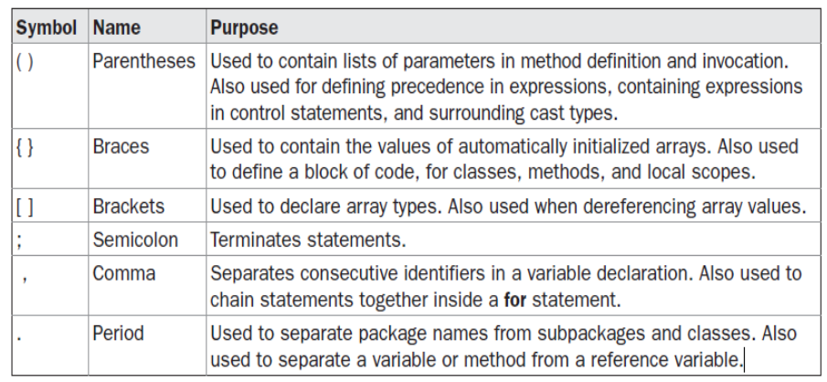
Separators

Slide 13
Java Keywords
abstract | *const | finally | implements | public | this
boolean | continue | for | instanceof | throw | transient
break | float | if | null | short | void
byte | default | import | int | super | volatile
case | do | false | return | switch | while
catch | double | interface | package | synchronized
char | else | long | private | static
class | extends | *goto | protected | try
true | final | new | native | throws
Keywords cannot be used as names for a variable, class or method

Slide 14
THANK YOU!!
ANY QUESTIONS??

